Slide 1
T3/Tutorials: Data Submission
Uploading marker information
https://triticeaetoolbox.org/

Slide 2
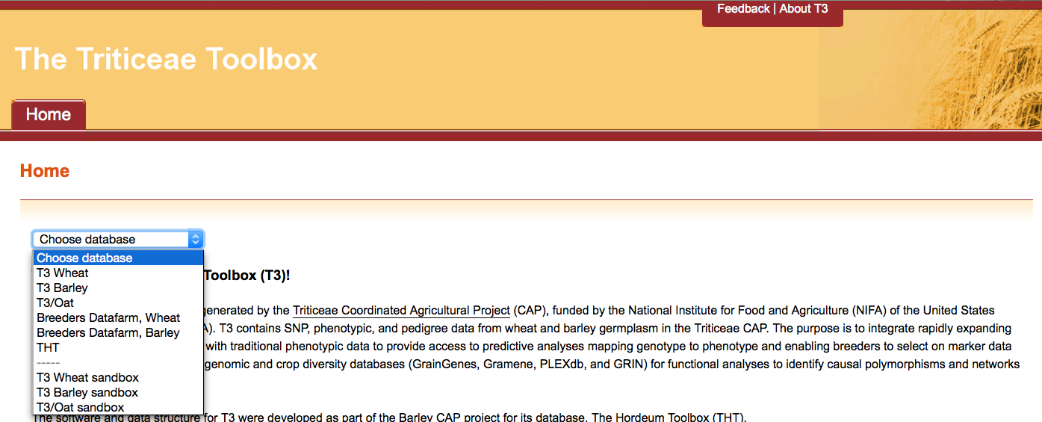
The Triticeae Toolbox (T3)
Each of the T3 databases can be reached from the T3 homepage: https://triticeaetoolbox.org
T3/Wheat will be used for demonstration purposes but these instructions are applicable to each instance of T3

Slide 3
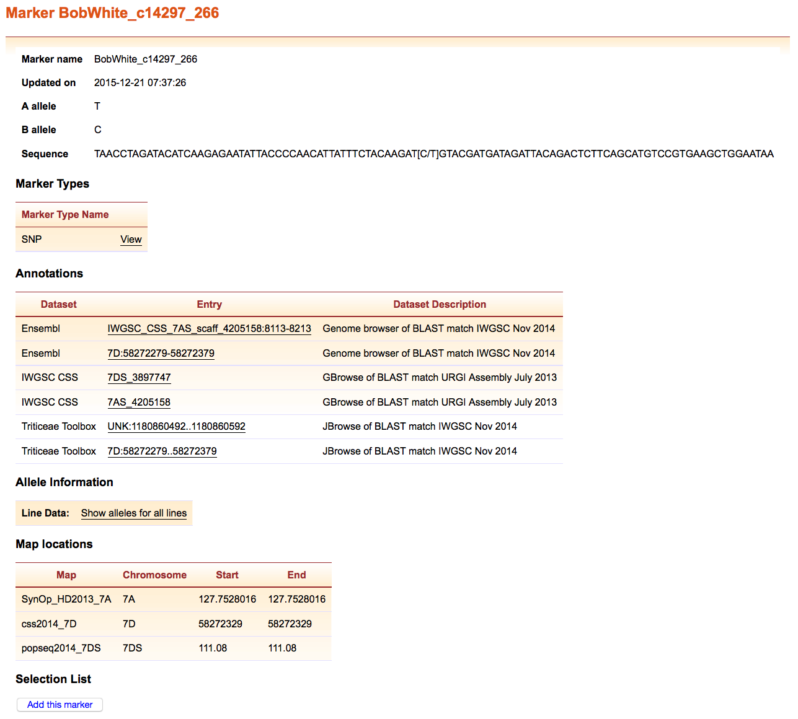
T3 marker records
The marker name is the unique identifier for a marker record
Marker information needs to be submitted before related genotype data can be uploaded to T3
Marker annotations for new or existing markers are uploaded to T3 using the same submission template

Slide 4
Tutorial 4: Outline
Searching existing marker records in T3
Downloading the marker submission templates
Completing the marker submission templates
Selecting a marker sequence template
Completing the marker annotation template
Completing a marker sequence template
Test loading the marker submission templates
Submitting the marker submission templates

Slide 5
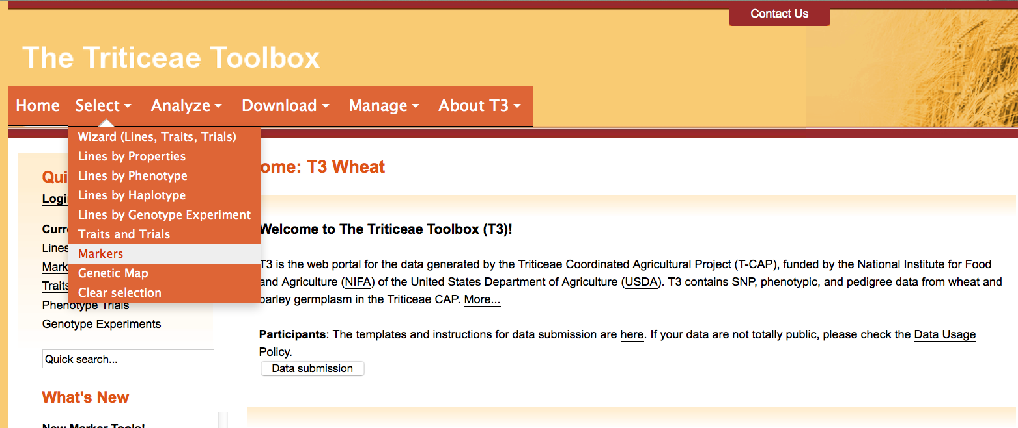
Section 1: Searching existing marker records in T3
Navigate to the T3 database homepage of your choice
e.g. https://triticeaetoolbox.org/wheat/
Choose the Select menu > Markers

Slide 6
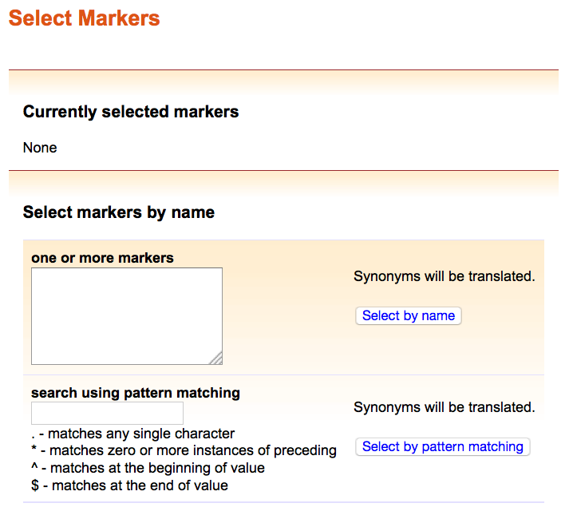
Section 1: Searching existing marker records in T3/Oat
Existing marker names can be queried by:
Exact marker name
Copy and paste (or type) a list of marker names into the window
Click “Select by name”
Approximate marker name
Enter a single name or name fragment into the window
Wildcard values can be used as described
Click “Select by pattern matching”

Slide 7
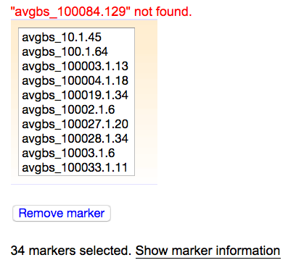
Section 1: Searching existing marker records in T3/Oat
Markers that are already stored in the database will appear in the results box
Click “Show marker information” to view or download the existing information for these markers
Markers that are not present in the database should be added using one of the marker submission templates

Slide 8
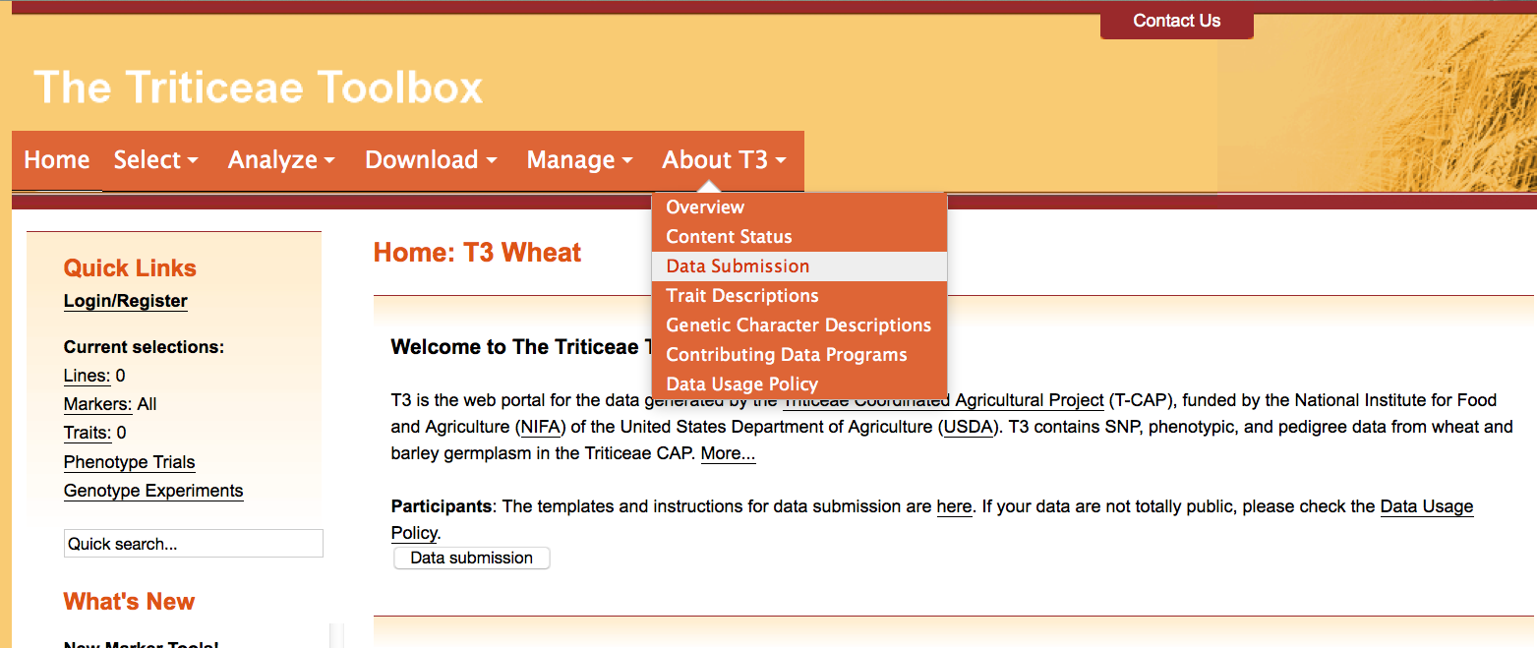
Section 2: Downloading a marker submission template
To download the marker submission template
Choose the About T3 menu > Data Submission

Slide 9
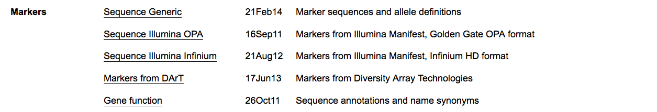

Section 2: Downloading a marker submission template
AKA the marker annotation template
The “Markers” section of the “Data Submission” page contains two categories of data upload template:
Templates for uploading marker sequences
The template for uploading marker annotations

Slide 10
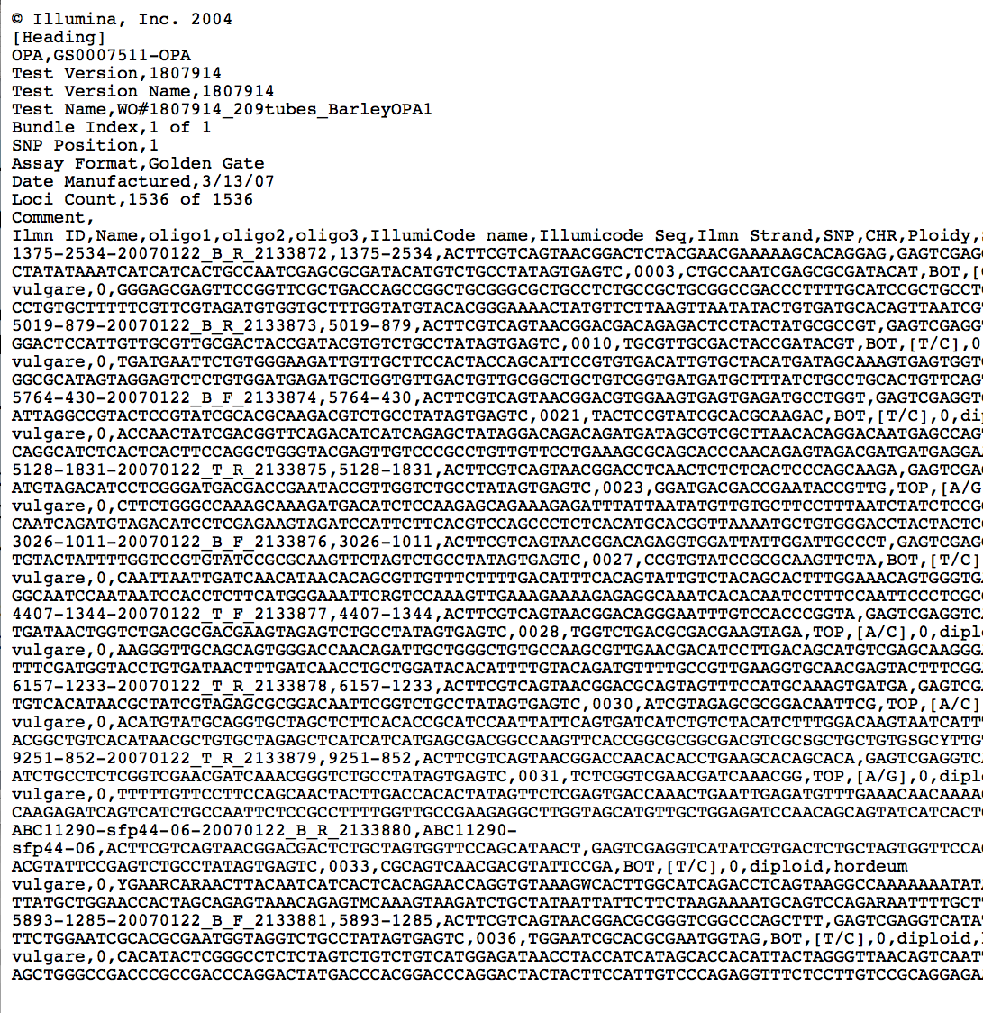
Section 2: Downloading a marker submission template
Each of the marker template links will take you to a webpage displaying the template
Right click the link and “Save Link As…” to download the file
Marker templates are in .txt or .csv format
This tutorial will use Excel to display the templates

Slide 11
Section 3.1: Selecting a marker submission template
Marker | T3 marker sequence template |  | Marker annotation template required
AB base calls | Illumina Manifest | OPA Golden Gate format | ✔
 |  | Infinium HD format | ✔
ACTG base calls | Generic format |  | ✖
DArT markers (A allele= 1, B allele= 2) | DArT format |  | ✔
New marker records are created with the marker annotation template
The marker sequence template can then be used to add sequence information to existing marker records
The “generic” marker sequence template can be used to create new marker records and therefore the marker annotation template is not required in this case

Slide 12
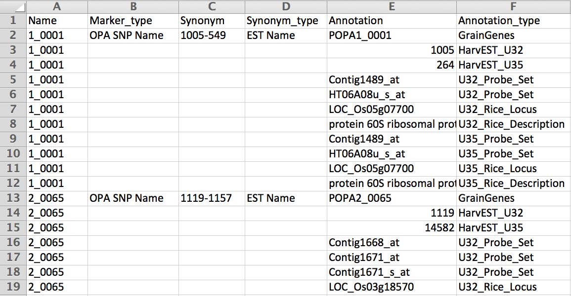
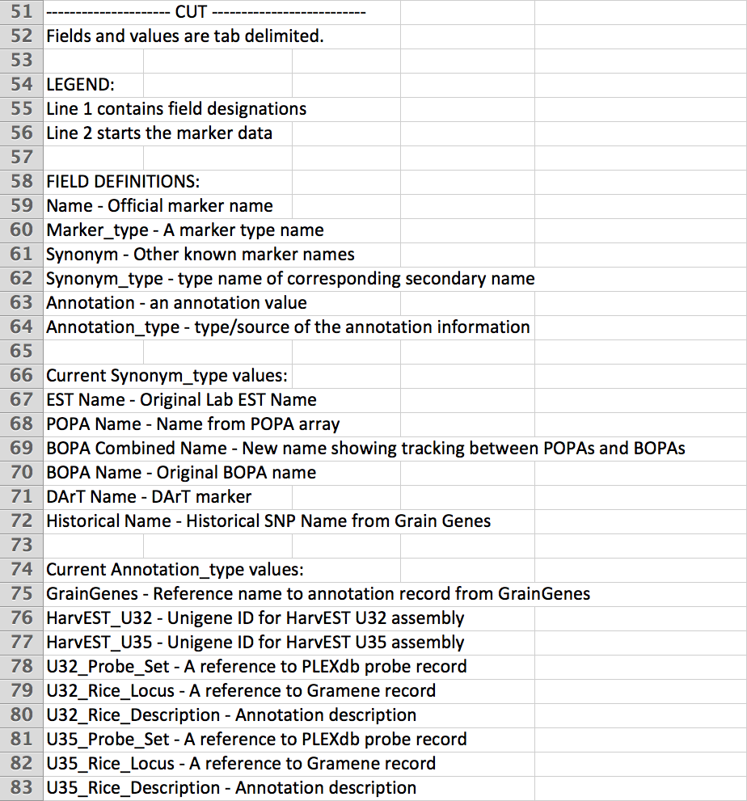
Section 3.2: Completing the marker annotation template
The marker annotation template
The marker annotation template is used to create new marker records in T3 or to provide additional information about existing markers
Marker name and marker type are the only required fields
Allowed marker types (as of March 2016):
The marker annotation template: notes section
AFLP
DArT Marker
GBS
Historical
Infinium
OPA SNP Name
QTL
RFLP
SNP
SSR
Please contact the curator if you require a new marker type to be added to T3

Slide 13
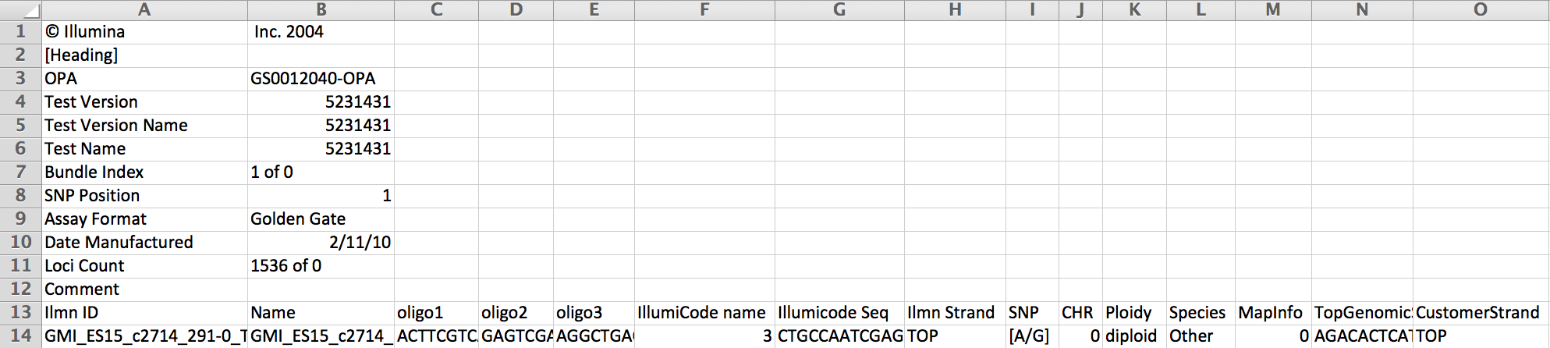
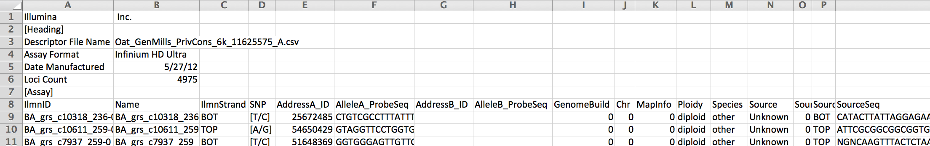
Section 3.3: Completing a marker sequence template
Two of the four marker sequence templates are designed for Illumina data, either in Golden Gate OPA or Infinium HD format
“Sequence Illumina OPA” submission template: Markers from Illumina Manifest Golden Gate OPA format
“Sequence Illumina Infinium” submission template: Markers from Illumina Manifest Infinium HD format

Slide 14
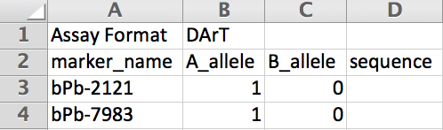
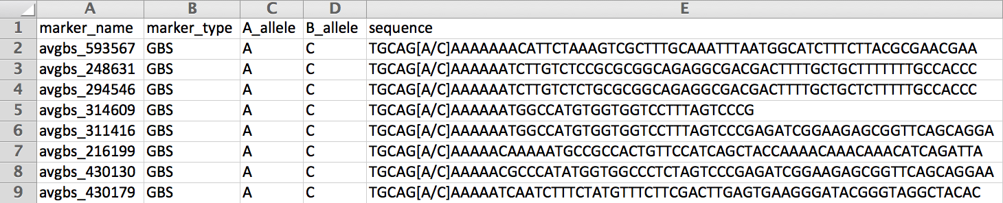
Section 3.3: Completing a marker sequence template
The remaining two marker sequence templates are designed for DArT data or to allow the submission of generic markers
The generic marker template should be used for GBS marker data
“Markers from DArT” submission template: Markers from Diversity Array Technologies
“Sequence Generic” submission template: Marker sequences and allele definitions
Please enter “Unavailable” in the sequence field if the marker sequence is not known

Slide 15
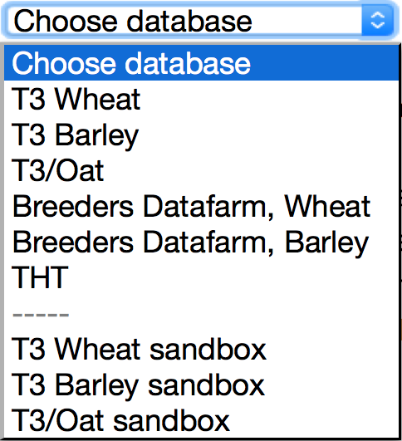
Section 4: Test-loading the marker submission templates
Each T3 database has a corresponding “sandbox”
Registered users can test-load data in these sandboxes
Data that is successfully uploaded to a sandbox can be submitted to the curator to be uploaded to the related production database
The production databases are the official repositories of T3 data
The sandboxes revert to an exact copy of the production databases each night

Slide 16
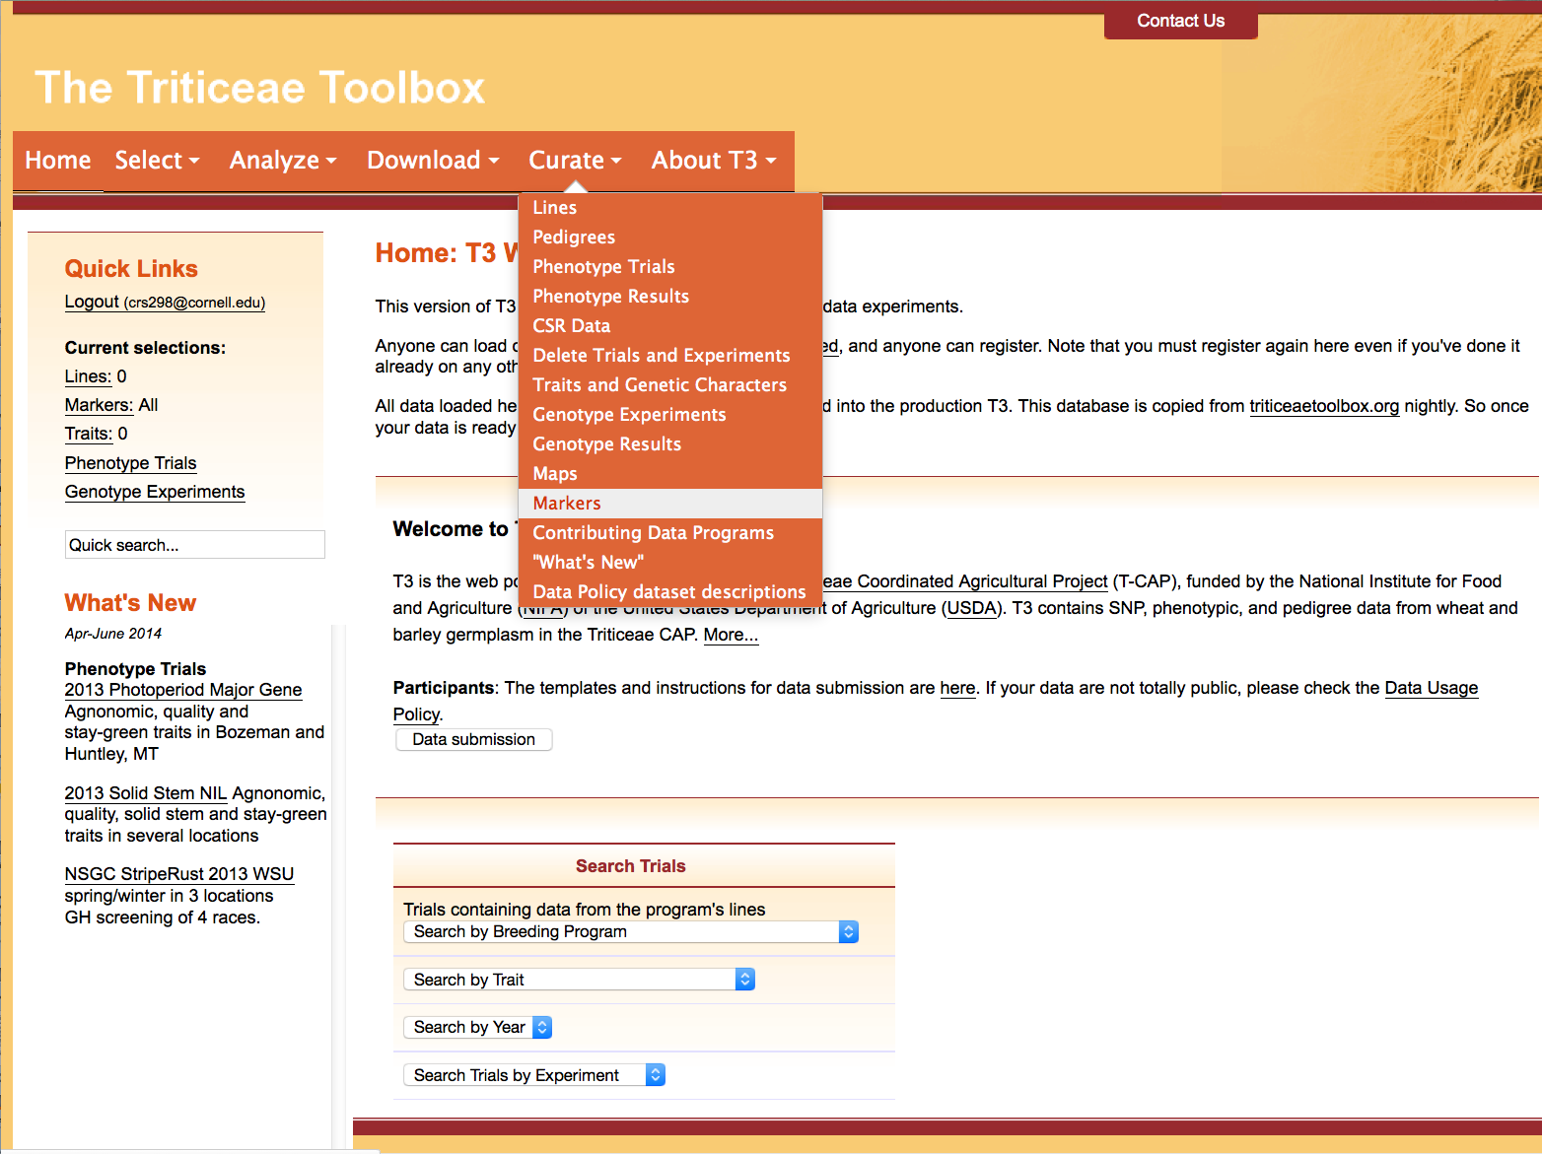
Section 4: Test-loading the marker submission templates
Navigate to the crop-specific T3 sandbox of your choice
e.g. https://t3sandbox.org/t3/sandbox/wheat/
The curation menu will appear once you register and login
Choose the Curate menu > Markers

Slide 17
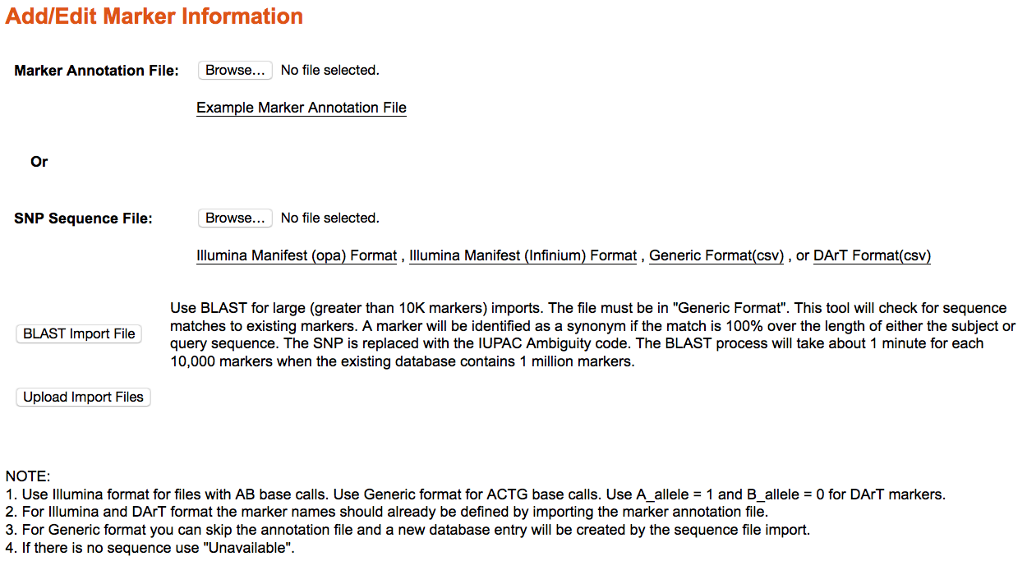
Section 4: Test-loading the marker submission templates
Select the completed template to test-load it in the sandbox
Remember to upload a marker annotation file before attempting to load Illumina or DArT marker sequences

Slide 18
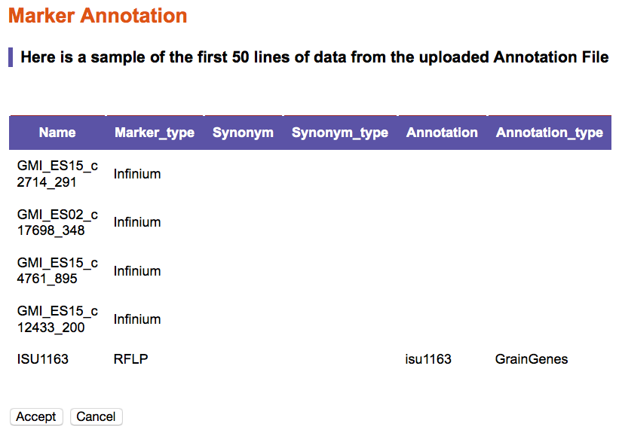
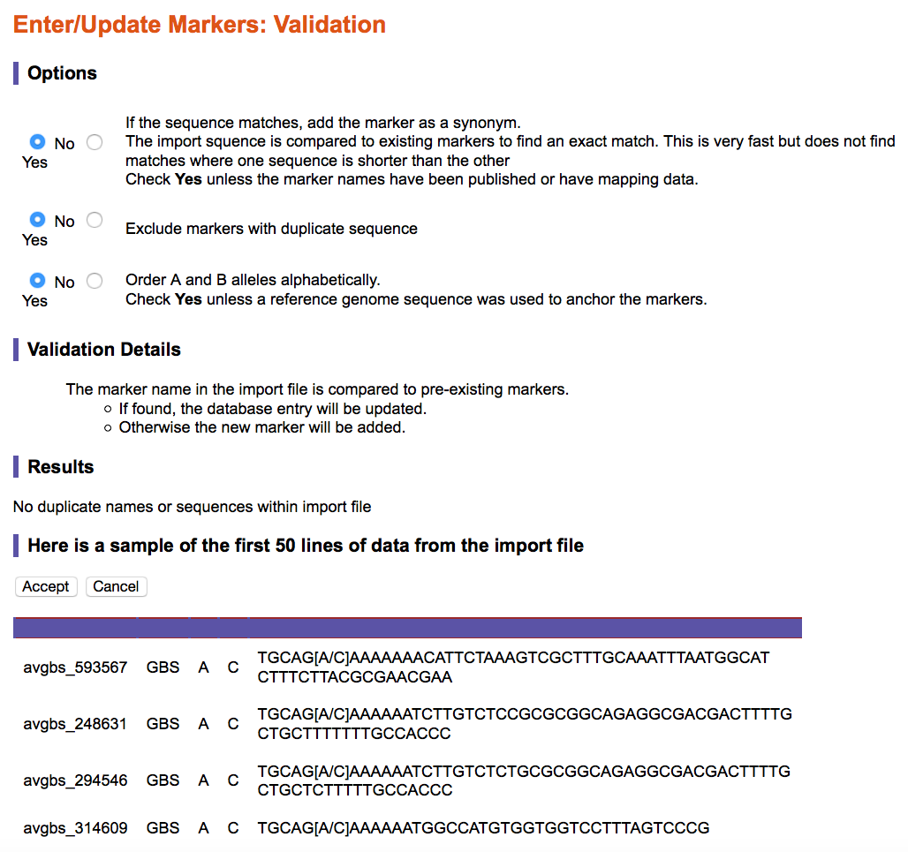
Section 4: Test-loading the marker submission templates
Marker annotation: Data validation window
T3 will highlight illegal entries in your upload file
The data validation windows shows how the database has read the upload file
Please take the time to validate that your data appears there correctly
Don’t forget to “Accept” the upload if the information is correct
Marker sequence: Data validation window

Slide 19
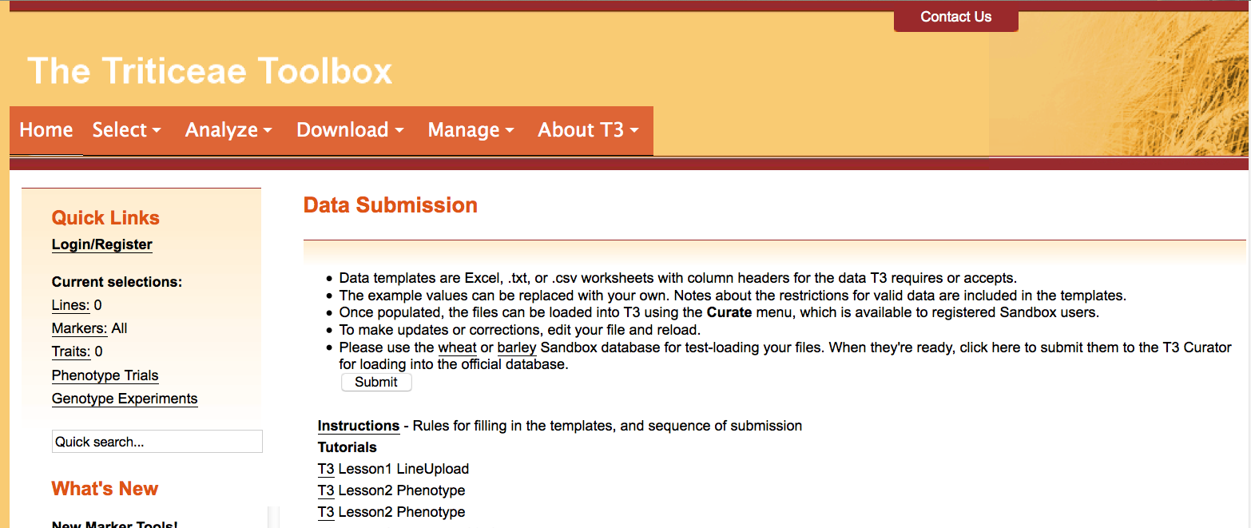
Section 5: Submitting the template
Finally, submit the templates to the curator for upload to T3
Login and then navigate to the Data Submission page
Click the “Submit” button

Slide 20
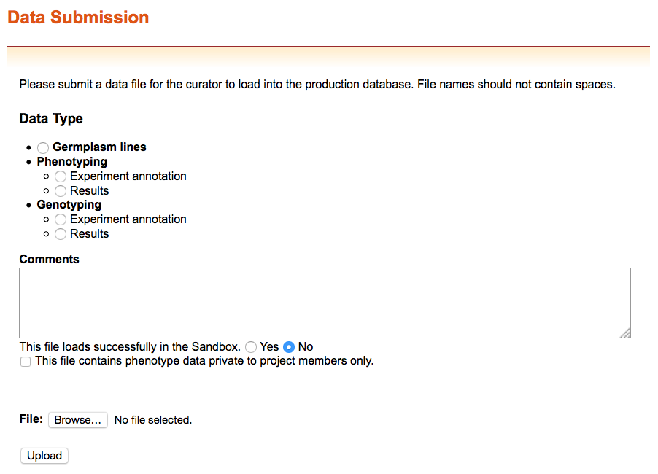
Section 5: Submitting the template
You can submit files that do not successfully upload to the sandbox to receive help from the curator

Slide 21
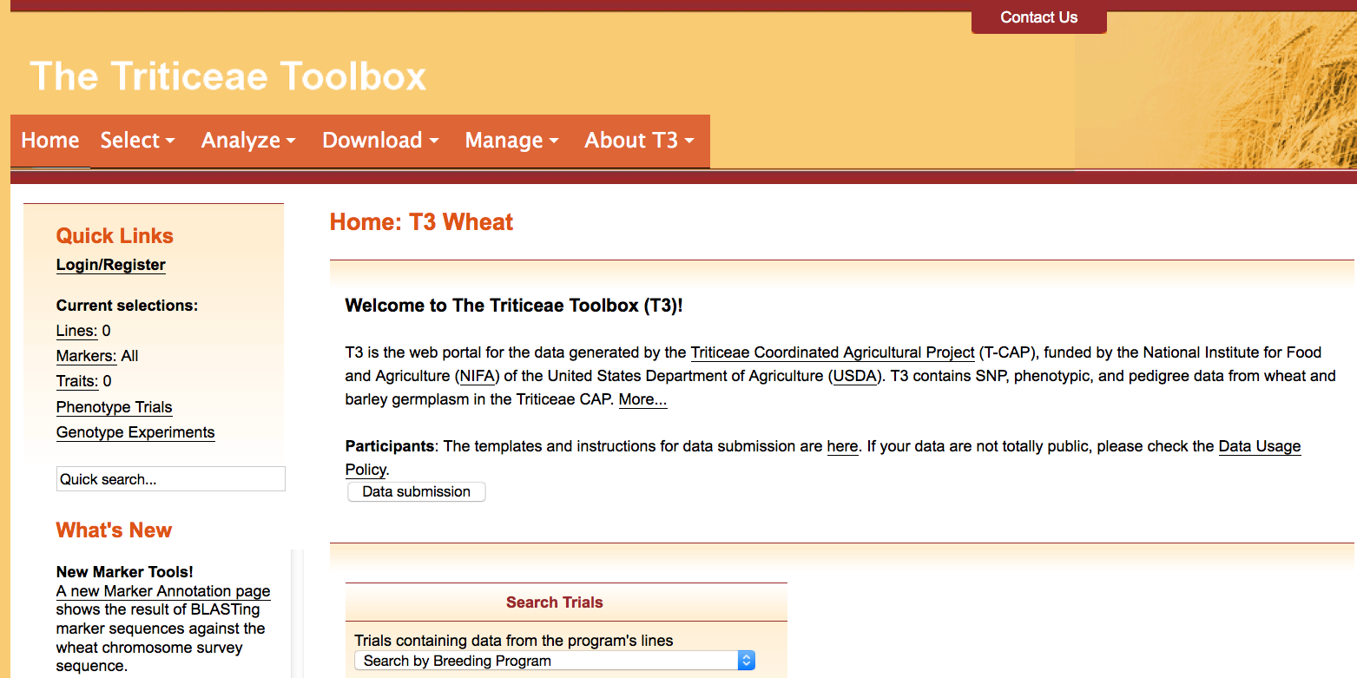
Contact Us
Please contact us if you need help using T3

